Slide 1
Technology Solutions Analyst Intern Prompt Report Machine learning and deep learning
Yidi Liu
Dec.3rd 2023
Notes:
Hello! This is the recorded presentation of prompt report for technology solutions analyst intern application. My name is Yidi Liu, and the topic I chose is Machine learning and deep learning.

Slide 2



Information
Repo: https://github.com/EdLiuNE/2023-Cotiviti-Prompt
Written Report:
Hackathon
Proof of Concept:
Recorded Video: WIP
Helper Data:
Notes:
Everything in this report packet should be in the repo. The packet contains the pdf and word format of the written report, the html and notebook format of the proof of concept, and a recorded video I’m working on now. There will be also two csv files as the data produced and used by the notebook, but they are not important if you didn’t run the notebook.

Slide 3
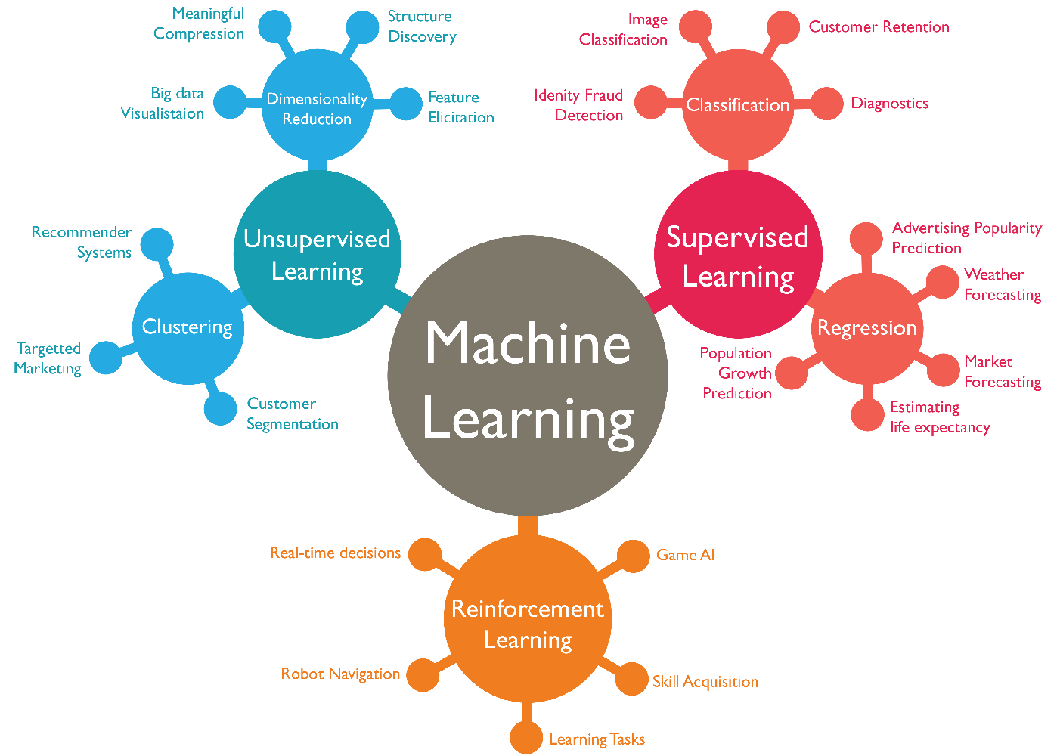
Abstract
https://www.wordstream.com/blog/ws/2017/07/28/machine-learning-applications
Notes:
Machine learning is no doubt the biggest trend nowadays. No matter what field it is, as long as it has anything to do with the word ‘data’, application of machine learning is inevitable. In this report we will introduce what machine learning as well as one of its most important branch, deep learning, is, and we will also briefly discuss why machine learning, or to be specific deep learning, is a suitable investigation target for Cotiviti.

Slide 4
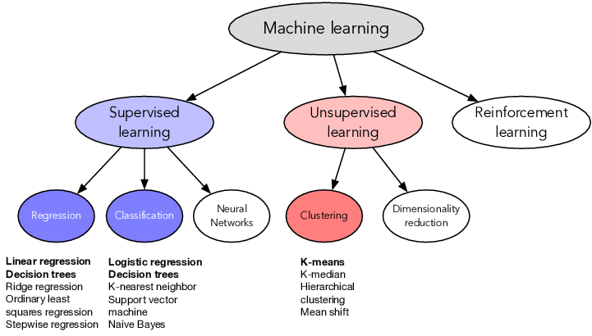
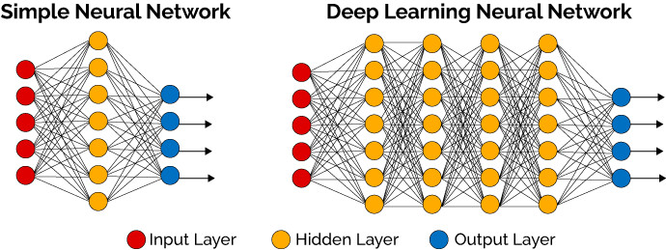
Background and concept
https://thedatascientist.com/what-deep-learning-is-and-isnt/
https://www.researchgate.net/figure/Machine-learning-algorithms-Colored-categories-specifically-bold-font-algorithms-are_fig1_362089646
Notes:
The concept of machine learning was initially defined in 1960s by Arthur Samuel, the pioneer of machine learning. Through decades of iterations, machine learning now has a big family, neural network is one of them. A neural network, aiming at simulating the biological neurons, has an input and an output layer, and also has one or more hidden layers for neurons. The more the hidden layers are, the deeper the neural network is, and then it is more complicated and is more likely to produce better results. When a network is deep enough, it then can be called as a deep learning network.

Slide 5
Background and concept
Classification and Prediction
X
y
Inference
y
X
Clustering
Anomaly Detection
X
X
X
X
X
X
X
Notes:
Depending on the models, machine learning is capable of various missions. Here we mainly focus on four of them: classifying or predicting the outcome y of features X, inferring X from a given y, clustering multiple Xs, and detecting X anomalies.

Slide 6
TPO Specificities
Contains sensitive PII (Personally Identifiable Information)
Normally has a huge volume
Is complex and contains both structured and unstructured data
Can be highly imbalanced
The model produced by them must be explainable.
Notes:
Before deciding which model to use, one key thing to know is most data that Cotiviti deals with is healthcare TPO data, where the TPO means treatment, payment, and operation of healthcare. TPO data has several specificities, including containing sensitive Personally Identifiable Information, having huge volumes, being complex and containing both structured and unstructured data, can be highly imbalanced, and the model produced by them must be explainable. These requirements sound strict, but is also kind of revealing the answer to the model selection.

Slide 7
Model Choice
Sensitive PII
Huge volume
Structured and unstructured data
Imbalanced
Explainable model
Scalability & Simplicity
Versatility
Notes:
Deep learning, with its scalability that enables parallelization on GPUs or TPUs, and its simplicity which removes the need for feature engineering, can have a good performance in facing of huge volumes of data, and it also have the versatility which makes it standing out in handling both general structured data and also unstructured data like pictures and voices.

Slide 8
Model Choice
Sensitive PII
Huge volume
Structured and unstructured data
Imbalanced
Explainable model
HIPAA
Scalability & Simplicity
Versatility
Over/Undersampling
SHAP
Notes:
The other three points are more like general problems not directly deciding the model, and they are all solvable. For A, the practise of introducing HIPAA into model constructions has already been proved possible by providers for example Amazon AWS, and for d and e, as traditional problems in machine learning, can be solved with techniques including oversampling or undersampling and SHAP.

Slide 9

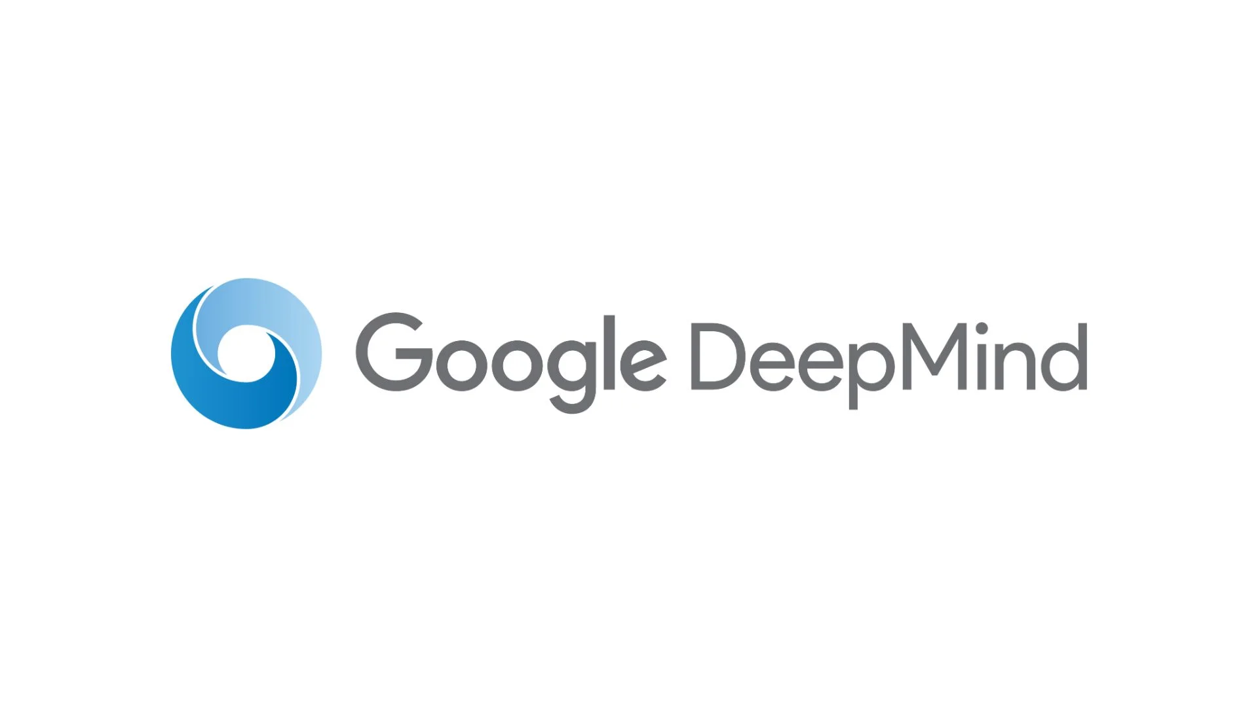
Conclusion
Notes:
So in conclusion, considering the role of Cotiviti as a company heavily related to TPO data, investment in deep learning may deserve the payback. There are already many companies providing deep learning services, so evaluating solutions like Amazon Sagemaker or Google Deepmind can be a good next step.

Slide 10
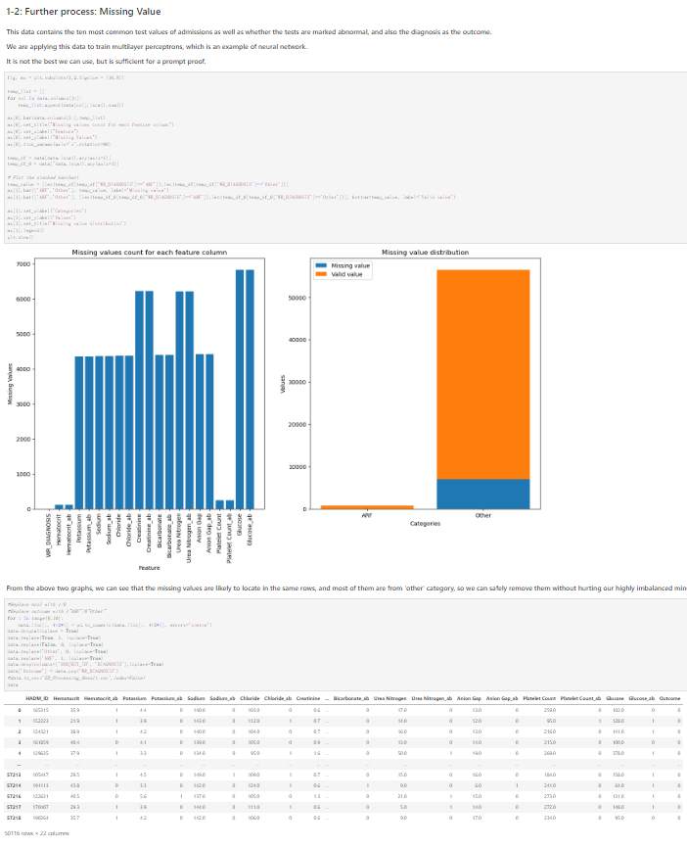
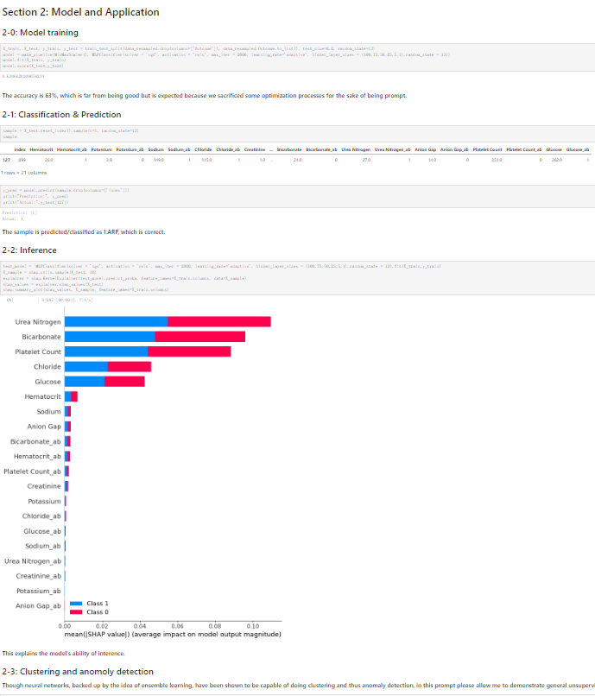
Poc demonstration
Notes:
In the later part of this video, I will go through a proof of concept notebook where I briefly proved how neural network, which is a shallow deep learning, as well as other machine learning models can achieve the high level targets as mentioned in the report.

Slide 11
Thank you!
Notes:
This is the end of this part of the video report. Sorry for it took a while for me to finish this, having four projects at the same time is not fun. Anyway, hope you like it, thank you so much for watching, and see you in the POC part.

